Slide 1
Application Design

Slide 2
Application design: a continuous process

Slide 3
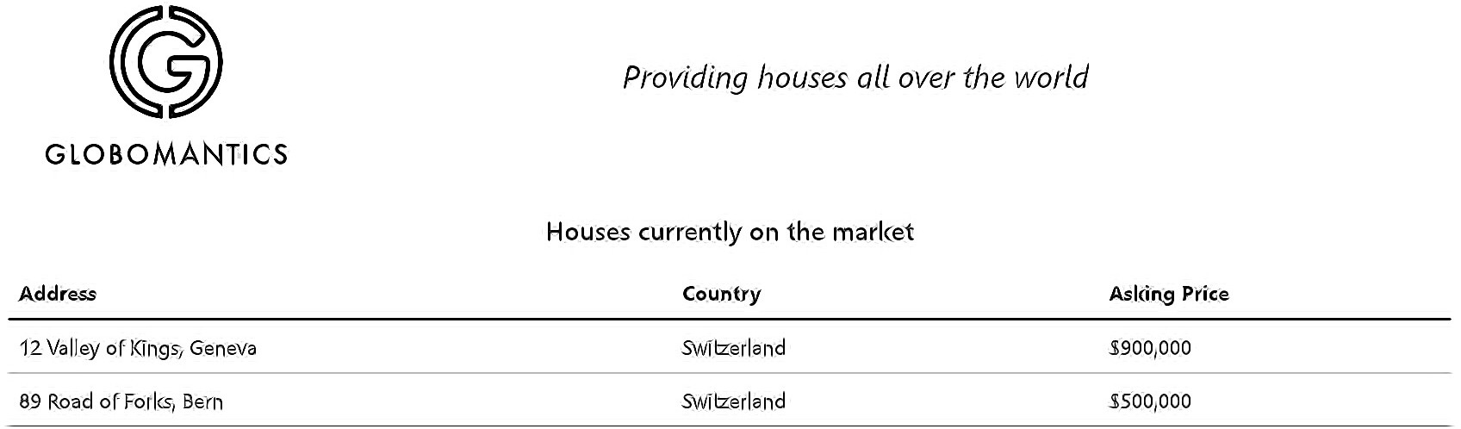
The Mock

Slide 4
No hard rules
Design Decisions
Often designer/team decision
Components that do too much are unwanted Design is a living thing

Slide 5
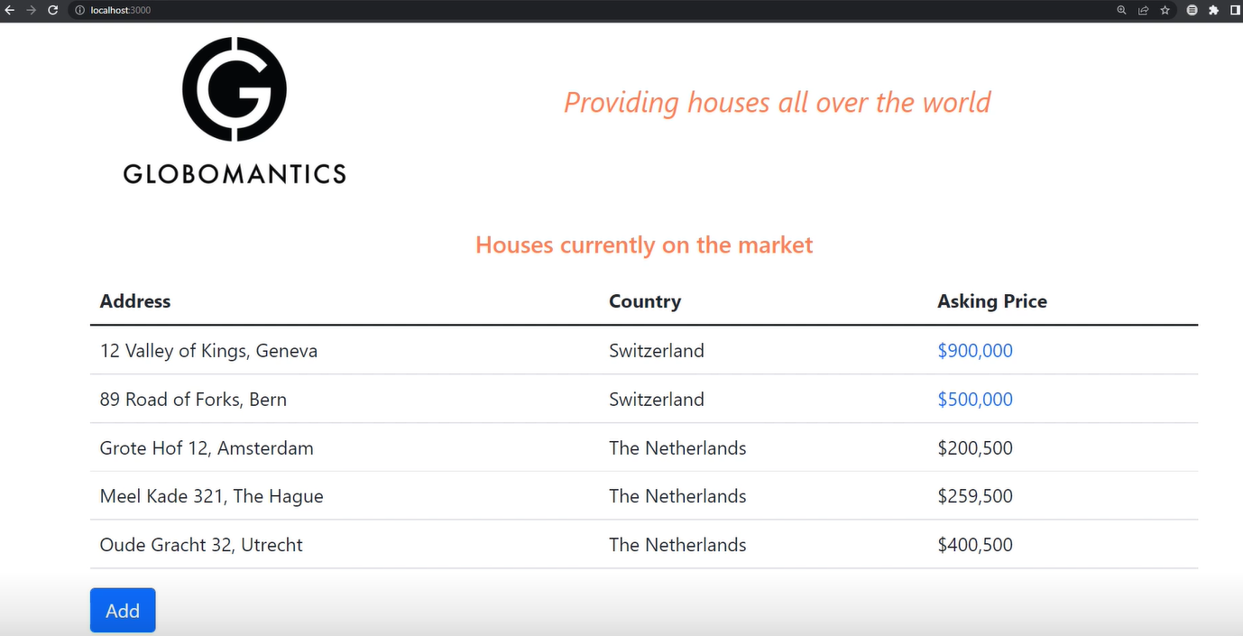

Slide 6
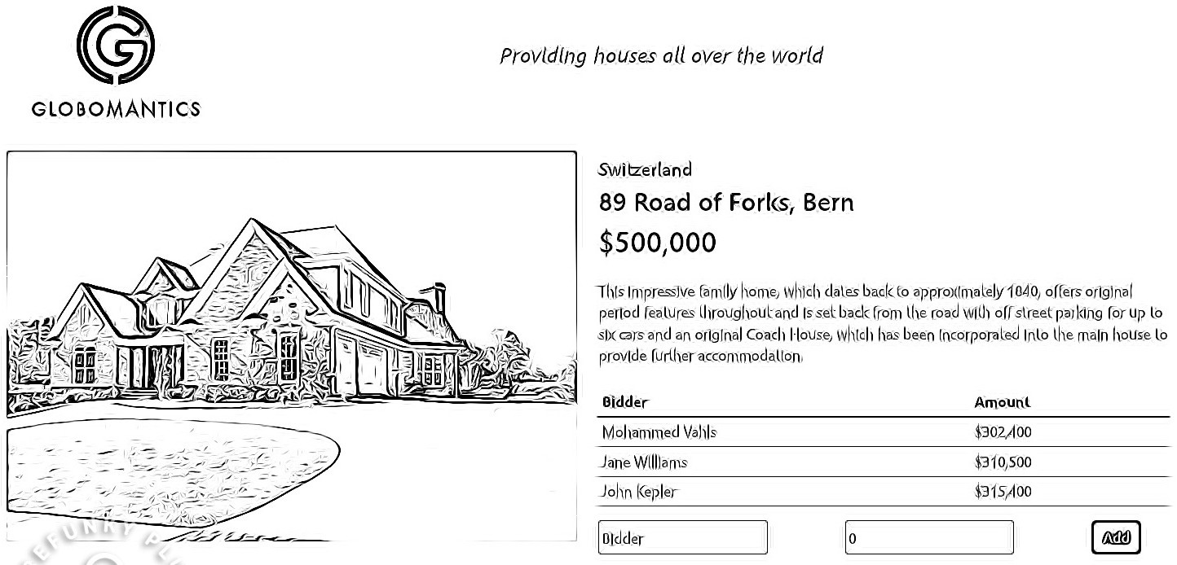
The Mock: House Composition

Slide 7
1. Break up Into a Component Hierarchy
App
Banner
HouseList
HouseRow
House
BidList
AddBid

Slide 8
File Structure
components app.js houseList.js house.js
… helpers
currencyFormatter.js
loadingStatus.js navValues.js
…
hooks
useHouses.js
useBids.js useGetRequest.js

Slide 9
File Structure
app.js houses
houseList.js house.js
useHouses.js
useBids.js
… customers
customerList.js
useCustomers.js
… common
currencyFormatter.js loadingStatus.js
navValues.js
useGetRequest.js
…

Slide 10
File Structure
app.js houses
index.js house.js useHouses.js useBids.js
… customers
index.js
useCustomers.js
…
import HouseList from "./houses"
import CustomerList from "./customers"
common currencyFormatter.js loadingStatus.js navValues.js useGetRequest.js
…

Slide 11
React doesn't have an opinion
Determining a File Structure
Choose something that works for the application at hand
Limit to 3 or 4 directory levels

Slide 12
No interactivity support
Without state
Create a First Application
Version
Just props
In-memory data source

Slide 13
When Application Data is a State Candidate
It is not passed in by the parent via a prop
It changes over time
It can not be computed

Slide 14
Determining Application State
Houses Yes
House count No Default house photo No Bids Yes
New Bid Yes

Slide 15
There is only one component that owns the state

Slide 16
Placing State
App
Banner
HouseList
HouseRow
House
BidList
AddBid

Slide 17
useState
Custom hook Context
How to Apply
State?

Slide 18
Applying State
What
Where
How

Slide 19
React's Data Flow

Slide 20
Inversing Data Flow

Slide 21
Inversing Data Flow
House
BidList
AddBid

Slide 22
Implementing Design Changes
App
Banner
HouseList
HouseRow
House
BidList
AddBid

Slide 23
Practice fundamentals first
Create an application by yourself Design first
Where to Go
Next

Slide 24
TypeScript
Redux React Query
Related Topics

